Slide 1
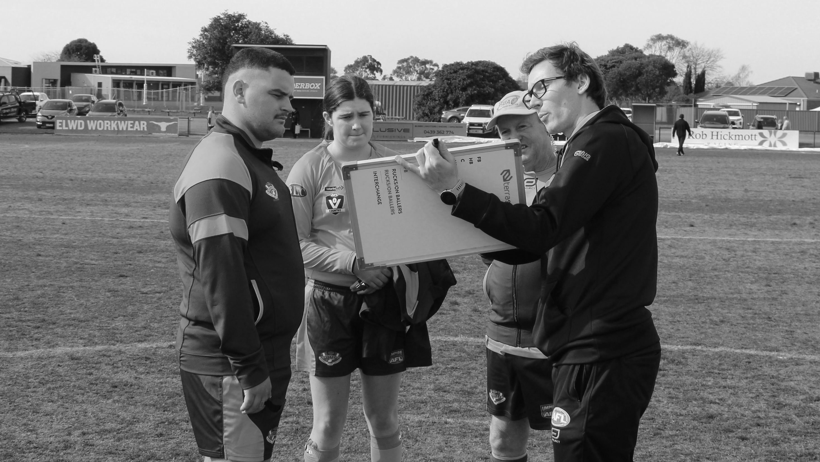
Welcome to SportsGauge
Introduction to SportsGauge

Slide 2
What is SportsGauge?
SportsGauge is an online platform used by umpire coaches and observers to submit, manage, and communicate umpire feedback
Accessible on any device for umpire coaches and observers
Designed to provide clear, structured feedback in an efficient way to support umpire development
Feedback forms developed by State League and Community Umpire Coaches

Slide 4
Receiving your Feedback Email
Your feedback will come from the sender: SportsGauge
Subject line: Umpire feedback from match Team 1 vs Team 2
If you haven’t received your feedback, check Junk/Spam/Other folders
IMPORTANT: “Mark as Safe” and/or “Trust Sender” so future emails go straight to your inbox

Slide 5
Feedback Forms
Senior Field
Senior Boundary
Senior Goal
In-depth feedback and assessment
Assists with pathway development
Finite skill development
Assists with finals selections
Development Field
Development Boundary
Development Goal
Targeted to early-stage umpires
Fundamental skill development
Shorter, more generalised assessment
Focused on encouragement and fun

Slide 6
Assessment Areas
FIELD
Decision Making
Game Skills
Management
Positioning
Values
BOUNDARY
Decision Making
Positioning
Anticipation
Skills (Throws)
Teamwork
Values
GOAL
Decision Making
Positioning
Teamwork & Communication
General
Values

Slide 7
What ratings will I receive?
“On Target” is a good outcome and should be the most common / expected.
Performing Well
Umpire is executing this part of their umpiring to a consistently high standard, and there are no obvious areas for further coaching.
On Target
Umpire is meeting the expected community-level standard in this part of their umpiring. Some variability in execution exists.
Let’s work on this together
Umpire should aim to develop this part of their umpiring in conjunction with their coach or mentors.

Slide 8
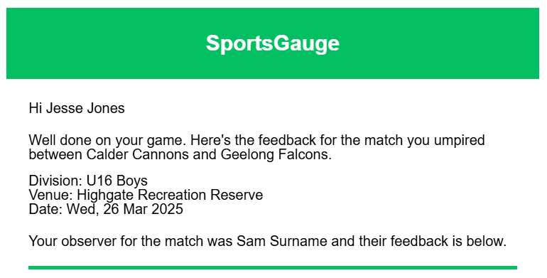
Feedback Email – Example (Senior Field)
Details of your game
Coach/Observer name

Slide 9
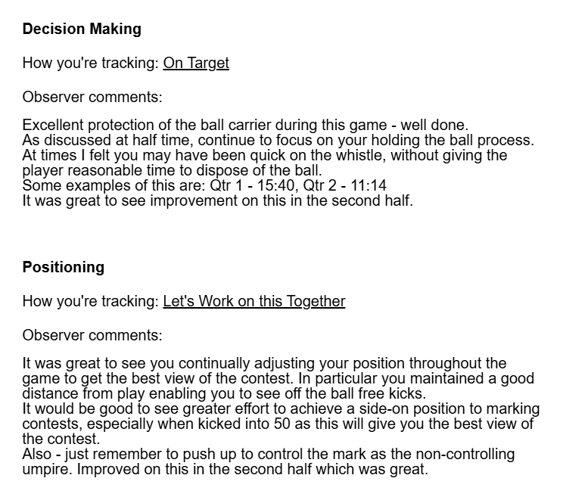
Rating, calculated by total inputs related
to this competency area
Observer comments

Slide 10
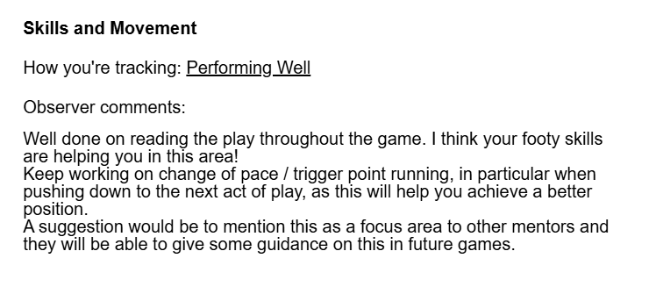
Some observers may
refer to examples on match footage

Slide 11
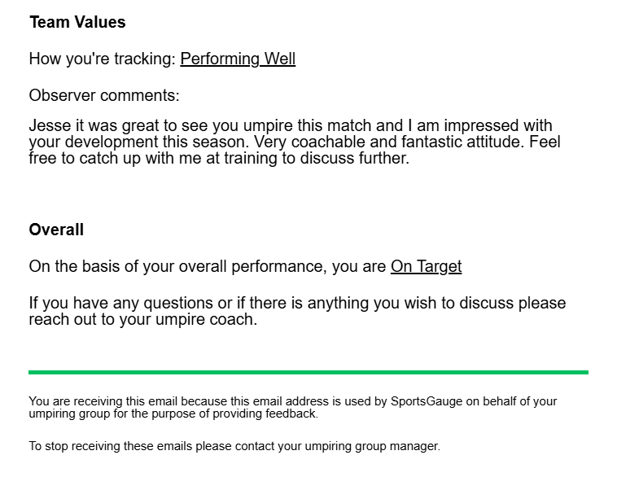
You’ll receive an overall rating based on all umpiring areas

Slide 12
PDF Attachment – Example (Positioning)
PDF shows details on
each specific area so you can see which areas of your umpiring are strengths and which areas you can focus on next week

Slide 13
Key Points
SportsGauge is a positive tool to help you develop your umpiring
AFL Victoria will develop coaching resources around the competencies on the feedback forms
Your feedback should prompt quality coaching conversations
Variations in feedback from observer to observer are normal – this happens at every level (including the AFL)
You will be able to easily access all feedback from the 2025 season – and hopefully see progression
Your feedback on SportsGauge at the conclusion of the season is greatly appreciated

Slide 14
Welcome to SportsGauge
Have a great season ahead!

